Slide 1
Capital Gains Tax

Slide 2
What is a capital gain (loss)?
If you sell a capital asset, such as real estate or shares, you usually make a capital gain or a capital loss (subject to exceptions).
1) Gain 2) Loss
Sale price $520,000 $300,000
Less: purchase price $300,000 $400,000
Capital gain / loss $220,000 ($100,000)

Slide 3
Who does it apply to?
If you’re an Australian resident, CGT applies to your assets anywhere in the world.
Foreign residents make a capital gain or loss if a CGT event happens to an asset that is 'taxable Australian property.’

Slide 4
Common CGT Assets
Property
Shares
Leases
Goodwill
Personal use assets purchased for more than $10,000
Collectables (such as jewellery, antiques, and artwork)

Slide 5
Question
Are the following CGT assets or personal use assets:
1. An engagement ring which cost $5,000?
Personal use – used or kept for personal use (less than $10K)
2. A second-hand car purchased for $2,000?
Personal use - Gains and losses from cars are exempt
3. Shares in BHP?
CGT asset
4. Your home?
CGT asset (but exempt under main residence exemption)
5. A holiday house at Torquay?
CGT asset

Slide 6
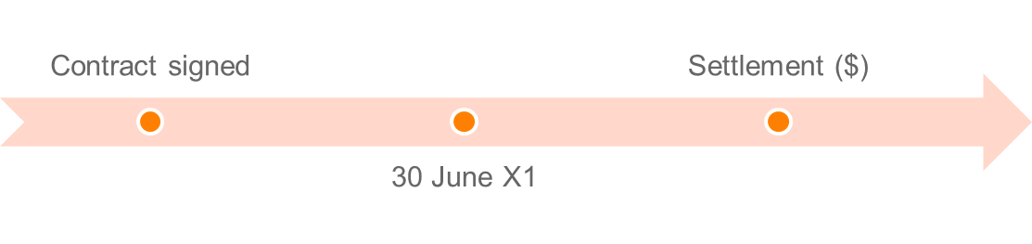
Time of the event
Contract date not settlement date
If you sign a contract to sell an investment property in June 2019, and settle in August 2019, you need to report the capital gain or loss in your 2018–19 tax return.
Pre CGT Exemption:
On or before 20 September 1985 = CGT exempt
After 20 September 1985 = Subject to CGT (unless otherwise excluded)

Slide 7
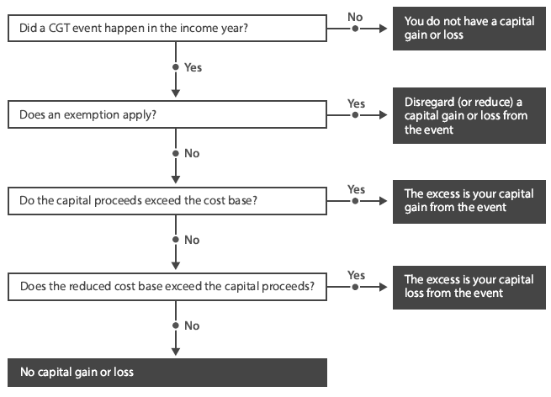
Methodology
Source: CA Program Study Guide– Tax: Unit 4

Slide 8
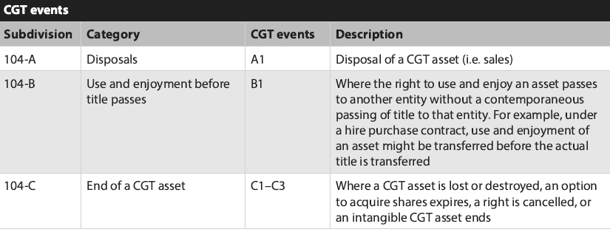
CGT Events

Slide 9
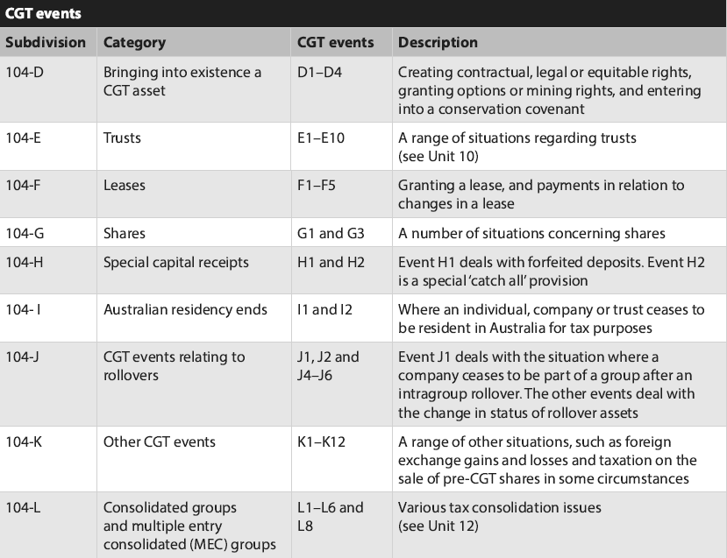
Source: CA Program Study Guide– Tax: Unit 4

Slide 10
Cost Base Elements
Element 1: Money or value of property given for acquisition
Money paid (or required to be paid) for the asset and the market value of property given (or required to be given) to acquire the asset.
Element 2: Incidental costs related to acquisition or disposal
Remuneration for legal advisor, accountant, valuer or auctioneer
Cost of transfer
Stamp duties
Marketing and advertising
Valuations
Search fees
Conveyancing
Borrowing expenses (not apportioned)
Termination or exit fees

Slide 11
Cost Base Elements
Element 3: Costs of ownership
You don't include these costs if you acquired the asset before 21 August 1991.
The costs of owning an asset include rates, land taxes, repairs and insurance premiums. You also include any non-deductible interest on loans used to finance:
The acquisition of a CGT asset
Capital expenditure to increase an asset’s value.
You can’t:
Include these costs in the cost base of collectables or personal use assets
Index these costs
Use them to work out a capital loss.

Slide 12
Cost Base Elements
Element 4: Capital expenses relating to the asset
Expense to increase or preserve asset’s value
Expense to install or move the asset
Does not include costs related to goodwill
E.g. Expenses for renovating a house would fall under this element
Element 5: Capital expenses relating to title/ ownership of the asset
Preserving the assets title
May arise where you litigate to reinforce your title.
  E.g. Litigation regarding adverse possession or land boundary disputes

Slide 13
Scenario
Frank has recently sold his beach house at Lorne. The beach house was acquired on 1 July 2015 for $600,000 and rented to tenants for the first two years.
From 1 July 2017 to the date of sale (30 June 2020), the property was used solely by Frank and his family for private use.
Frank has asked you to calculate the capital gain or loss on the sale of the beach house.

Slide 14
Scenario
What cost base elements do the below examples fall into:
1. Purchase price: $600,000?
Element 1: Money given for acquisition
2. Stamp duty paid to the Victorian Government: $80,000?
Element 2: Incidental costs related to acquisition or disposal
3. Repairs (which were not expensed): $6,600?
Element 4: Capital expenses relating to the asset
4. Legal fees relating to 2018 boundary dispute with neighbour: $4,000?
Element 5: Capital expenses relating to title/ ownership of the asset
5. Land tax: $6,000 (deducted in 2017 tax return)?
Does not form part of the cost base
6. Agent’s commission: $30,000?
Element 2: Incidental costs related to acquisition or disposal
7. Fine imposed by Surf Coast Shire for erecting illegal ‘For Sale’ signs (breach of Local Government Act 1989): $300?
Does not form part of the cost base

Slide 15
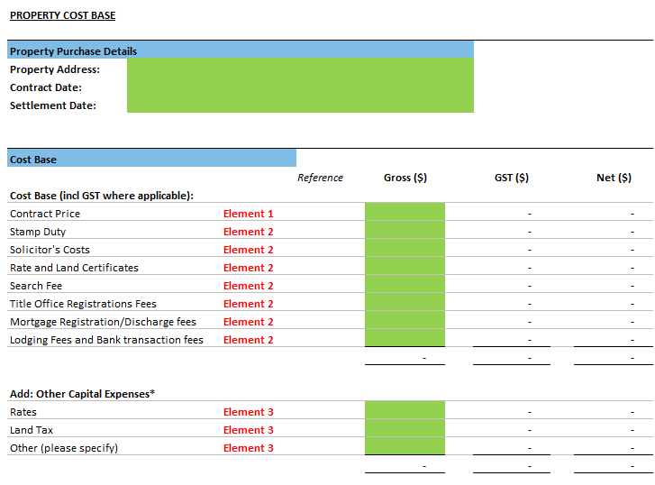
Cost Base Elements

Slide 16
Modifications to capital gains
Market value substitution rule
Apportionment rule
Non-receipt rule
Repaid rule
Assumption of liability rule
Misappropriation rule

Slide 17
1. “Market value” Modification
Applies when the taxpayer:
  Receives no capital proceeds;
  Some or all capital proceeds cannot be valued; or
  Did not deal at ‘arm’s length’ with the other entity.
Capital proceeds are deemed to be the market value.
‘Arms-length’: an unrealistic value for purchase normally because of the relationship (e.g. Candice sold me her house for $10 because we’re friends).
Would the reasonable person consider the sale at arm’s length?

Slide 18
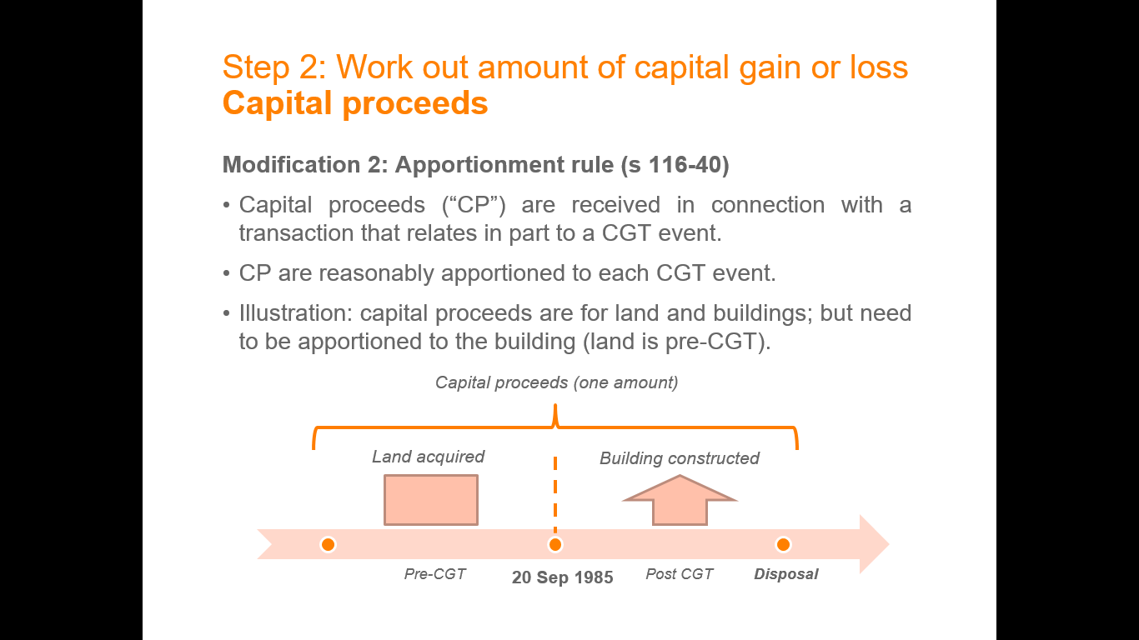
2. Apportionment Modification
When a single proceed is the total of two or more events, the proceeds must be apportioned between those events.
E.g. A lump sum of $800,000 for the sale of house and a yacht, these will need to be apportioned to determine the value of each

Slide 19
3. Non-receipt Rule
Allows the Capital Proceeds to be reduced by any amount that you have not received and will not receive after all reasonable attempts have been made to get it.
Capital proceeds are reduced to the extent the taxpayer has to repay capital proceeds already received.
4. Repaid Rule

Slide 20
5. Assumption of Liability Rule
Capital proceeds are increased if another entity assumes liability in connection with the CGT event.
E.g. John sells apartment. The purchaser paid him $250,000 and took over $50,000 debt.
Capital proceeds will equal $300,000
Allows you to reduce capital proceeds by any amount misappropriated by an employee or agent.
E.g. Real estate agent takes the 10% deposit from a house sale, this 10% will be deducted
6. Misappropriation Rule

Slide 21
Exempt Assets
Cars and motorcycles - (s 118-5)
Personal use assets - (s 109-20)
Assets used to produce exempt income - (s 118-12(1))
Shares in a pooled development fund - (s 118-13)
Investments made in start-up companies - (Subdiv 360-A)
Depreciating assets - (s 118-24(1))
Trading stock - (s 118-25)
Personal compensation – (s 118-37(1)(a) & (b))
      Personal wrong, injury or illness
Private lease ending – (s 118-40)
Gambling and competitions with prizes – (s 118-37(1)(c))

Slide 22
Exemptions
Main residence exemption;
50% discount (if held for 12 months or more);
15-year exemption;
50% active asset exemption;
Retirement exemption; and
Rollover; and
  Small business restructure rollover (accessible for businesses with 10M or less turnover);
SBE Concessions

Slide 23
Main residence exemption
Any capital gain or capital loss that an individual taxpayer makes from a CGT event happening in relation to a dwelling (or interest in a dwelling) that is the person’s main residence is disregarded.
A dwelling includes a unit of accommodation that is:
a building or is contained in a building, and consists wholly or mainly of residential accommodation; and
a caravan, houseboat or other mobile home,
and any land immediately under the unit of accommodation (s 118-115).
The MRE applies only where an individual or individuals make the capital gain. For example, the exemption cannot apply to a residence that is owned by a family trust even if the family occupies it as their main residence.

Slide 24
Main residence exemption
Adjacent land
Where a CGT event also happens to land adjacent to a dwelling (or part of the dwelling), that is also used primarily for private or domestic purposes, the exemption will apply to a total of two hectares of land. That includes the land on which the dwelling is built. A taxpayer can choose the two hectares to which the MRE applies. Refer to TD 1999/67 for examples.

Slide 25
Changing main residences
Where a taxpayer acquires a dwelling that is to become a main residence, and already has a main residence, both residences can benefit from the exemption for the shorter of:
six months (ending when the CGT event happened to the existing residence); or
the period from the acquisition of the new residence to the CGT event happening to the existing residence.
However, this exemption is only available if the existing main residence was the main residence for at least three months in the 12 months prior to the CGT event, and provided that it was not used to produce assessable income in that 12-month period when it was not the main residence.

Slide 26
Scrip-for-scrip (Takeovers and Mergers)
If a company in which you own shares is taken over or merges with another company, you may have a capital gains tax (CGT) obligation.
When a company launches a takeover bid by buying shares in the market, they offer money in return for shares. If a company launches an off-market takeover bid, they don’t always offer cash in return for shares – they can either offer money or scrip (shares), or a combination of these.
When you receive shares, you may be able to defer paying capital gains tax until a later CGT event happens (however the cost base will carry forward from the original company’s shares).
You can choose not to apply this rollover. The rollover does not apply where a capital loss would arise.

Slide 27
Indexation - Eligibility
A capital gains tax (CGT) event happened to an asset you acquired before 11.45am (EST) on 21 September 1999; and
You owned the asset for 12 months or more.
If you're a company and the capital gain meets the above conditions, you must use the indexation method to calculate the capital gain.

Slide 28
Record keeping
What needs to be recorded:
All transactions effecting CGT events
Date of acquisition and disposal
Each cost base element
Consideration on disposal
Parties to the transaction
Retain records for 5 years after disposal

